Slide 1
DIGITAL TRANSFORMATION FOUNDATIONS
Cloud, AI, IoT & Blockchain
Understanding four core technologies driving data-driven, automated modern enterprise operations.
Cloud Computing
Artificial Intelligence
Internet of Things
Blockchain

Slide 2




Executive Overview
The Four Pillars at a Glance
IoT
Cloud
AI
Blockchain
COLLECT
STORE & PROCESS
ANALYSE & PREDICT
VERIFY & TRACE
Captures real-world telemetry from physical objects and sensors.
Maintains immutable, shared digital transaction records.
Provides scalable compute infrastructure accessible anywhere.
Evaluates patterns to automate workflows and intelligent decisions.

Slide 3

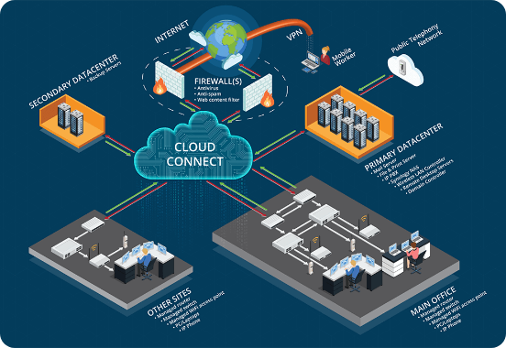
Pillar 01
Cloud Computing: Elastic Resources
On-Demand Infrastructure Over Internet
Instead of purchasing physical servers, organisations deliver and manage computing power, databases, storage, and software through web-accessible platforms.
Traditional vs Cloud Paradigm
Traditional hardware maintenance requires high upfront capital. Cloud allows dynamic resource scaling as demand shifts.

Slide 4
Cloud Architecture
Key Benefits & Enterprise Application
Dynamic Scalability
Cost Efficiency
Global Access
Instant capacity expansion during spike events like Black Friday sales without physical hardware upgrades.
Eliminates high initial server acquisition costs and continuous on-premises infrastructure maintenance expenses.
Enables remote multi-user document collaboration across Netflix streaming, Google Drive, and Microsoft 365.

Slide 5
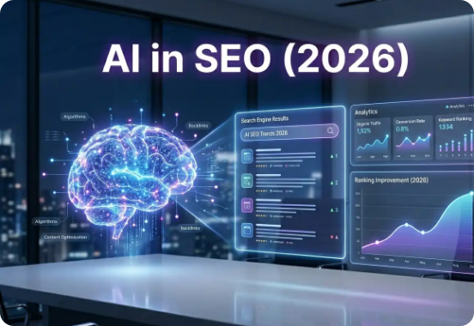
Pillar 02
Artificial Intelligence: Cognitive Automation
Simulating Human Cognitive Tasks
AI enables systems to analyse massive datasets, recognise complex patterns, make predictive recommendations, and automate administrative decision workflows.
Pattern Recognition: Detects subtle anomalies and customer trends.
Predictive Insights: Forecasts future demand and operational needs.
Hyper-Personalisation: Tailors content directly to user preferences.

Slide 6
AI Implementations
Real-World Industry Applications
E-Commerce & Media
Banking Fraud Detection
Adaptive Education
Personalises shopping suggestions and content feeds based on viewing habits and search queries.
Identifies unusual transaction patterns instantly to block suspicious overseas financial activity.
Evaluates student performance metrics to deliver customized learning materials and support.

Slide 7
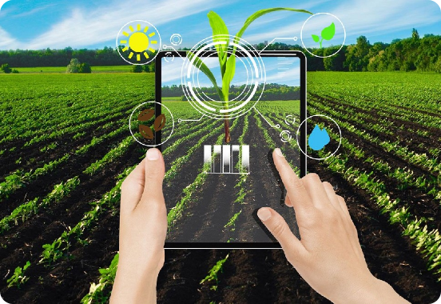
Pillar 03
Internet of Things: Physical Connectivity
Connecting Physical Assets to Networks
Physical objects embedded with sensors, software, and network capability gather real-time telemetry from the environment without manual human intervention.
Core IoT Execution Pipeline
Physical Object → Sensor → Network → Data → Automated Action

Slide 8
IoT Applications
Real-Time Operational Intelligence
Smart Agriculture
Cold Chain Storage
Predictive Maintenance
Soil sensors detect moisture levels at 20% and automatically trigger precision field irrigation systems.
Temperature monitors alert warehouse staff immediately if vaccine or fresh produce storage exceeds 12°C.
Vibration sensors flag machinery anomalies before catastrophic failure occurs in manufacturing plants.

Slide 9
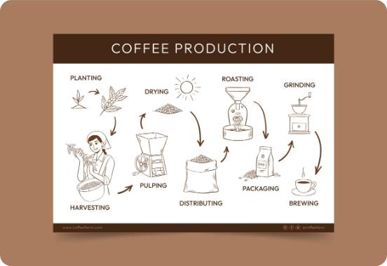
Pillar 04
Blockchain: Verifiable Shared Ledgers
Tamper-Resistant Decentralised Records
Information is recorded in sequential blocks distributed across network participants, ensuring records remain immutable once confirmed.
01
Full Traceability
Track product origins and financial movements end-to-end.
02
Smart Contracts
Automatically release payments when delivery conditions are verified.

Slide 10
Supply Chain Verification
Traceability Case: Ethical Organic Coffee
STAGE 1
STAGE 2
STAGE 3
STAGE 4
Farmer
Processor
Distributor
Retailer
Records harvest origin and organic verification.
Logs batch processing metrics and date stamps.
Tracks shipment route and transit conditions.
Verifies inventory receipt and shelf display.

Slide 11
System Synergy
How The Four Pillars Integrate
1. IoT
Collects Data: Vehicle sensors record truck GPS, temperature, fuel rate, and mechanical metrics.
2. Cloud
Stores Data: Sensor telematics stream securely into central cloud infrastructure dashboards.
3. AI
Analyses Data: Algorithms detect fuel anomalies and schedule preventive maintenance alerts.
4. Blockchain
Verifies Data: Records delivery confirmation and contract execution permanently across parties.

Slide 12

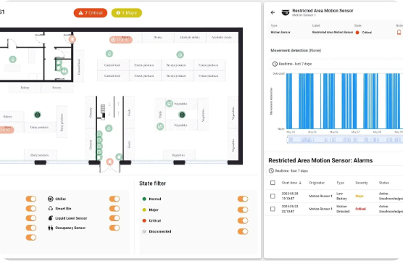
Integrated Scenario
The Modern Smart Supermarket
IoT + CLOUD
Sensors monitor fridge temperature and stock levels; streams directly to management dashboard.
AI PREDICTION
Predicts 30% weekend demand surges for stock items and automates reordering.
BLOCKCHAIN TRUST
Customers scan product tags to verify farm-to-shelf organic supply chain history.

Slide 13





Image Sources
https://www.itaf.eu/wp-content/uploads/2021/08/Picture3.png
Source: www.itaf.eu
https://flexiv.com.pk/wp-content/uploads/2026/05/The-Role-of-AI-in-Shaping-the-Future-of-SEO-in-2026.webp
Source: flexiv.com.pk
https://www.niubol.com/static/upload/image/20251110/1762760391210487.jpeg
Source: www.niubol.com
https://nordico.coffee/wp-content/uploads/2023/07/26249625_7174293-scaled.jpg
Source: nordico.coffee
https://thingsboard.io/_astro/smart-retail-3.BDHkklTS_jgqRW.webp
Source: thingsboard.io

